Slide 1
IBM AICTE PROJECT INTELLIGENT SCHEME CLASSIFICATION OF
PMGSY PROJECTS USING IBM CLOUD
Presented By:
1. SAUMYA PAL (RAJKIYA ENGINEERING COLLEGE,
KANNAUJ) (Department: Computer Science and
Engineering)

Slide 2
OUTLINE
Problem Statement (Should not include solution)
Proposed System/Solution
System Development Approach (Technology Used)
Algorithm & Deployment
Result (Output Image)
Conclusion
Future Scope
References

Slide 3
PROBLEM STATEMENT
The Pradhan Mantri Gram Sadak Yojana (PMGSY) is a flagship rural development program that provides all-weather road connectivity to unconnected habitations.
Over time, the program has evolved through various schemes (PMGSY-I, PMGSY-II, RCPLWEA), each with specific criteria.
Manually classifying thousands of ongoing and completed projects into the correct
scheme is time-consuming and prone to errors.
There is a critical need for an intelligent system to automate this classification using available project data.

Slide 4
PROPOSED SOLUTION
The proposed system is a machine learning-based classifier that predicts the correct PMGSY scheme (PMGSY-I, II, RCPLWEA) for a given rural infrastructure project based on:
Physical characteristics (project length, type, geography)
Financial data (estimated cost)
Geographic attributes (state, district)
The goal is to assist government bodies and planners in quickly categorizing projects, improving monitoring, and enabling better policy decisions.

Slide 5
SYSTEM APPROACH
Tools & Technologies Used:
Platform: IBM Cloud Lite
Notebook Environment: IBM Watson.ai Studio
Modeling Libraries: scikit-learn, pandas, matplotlib
Deployment: IBM Watson Machine Learning
Data: PMGSY dataset from AI Kosh
Preprocessing:
Remove null values
Derived features like cost_per_km , completion_ratio
Encoded Categorical Fields (eg. State,district)

Slide 6
ALGORITHM & DEPLOYMENT
Algorithm Used: Batched Tree Ensemble Classifier (XGB Classifier)
Input Features:
STATE_NAME, DISTRICT_NAME
NO_OF_ROADS_SANCTIONED, LENGTH_SANCTIONED
COST_OF_WORKS_SANCTIONED, LENGTH_COMPLETED
NO_OF_BRIDGES_SANCTIONED, COST_BALANCE, LENGTH_BALANCE etc…
Target Variable: PMGYSY_SCHEME
Cross Validation Accuracy: 92.4%
Deployment:
Model trained via AutoAI on IBM Watson Studio
Deployed using Watson Machine Learning
REST API created for inference

Slide 7
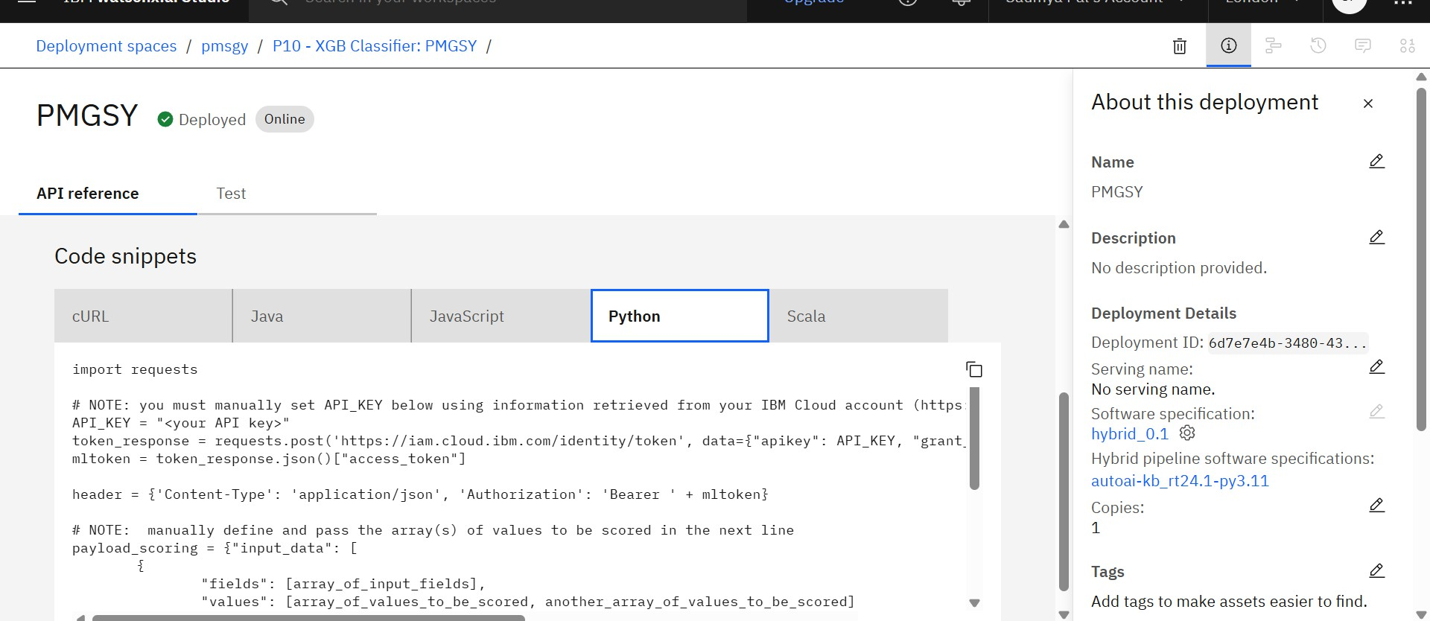

Slide 8
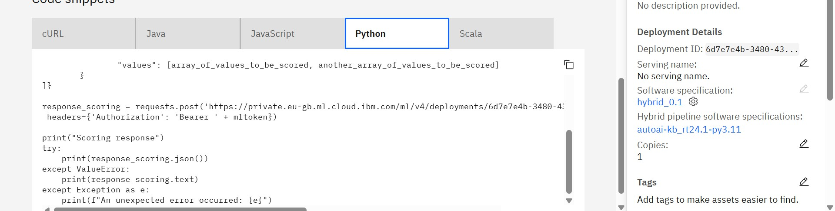

Slide 9
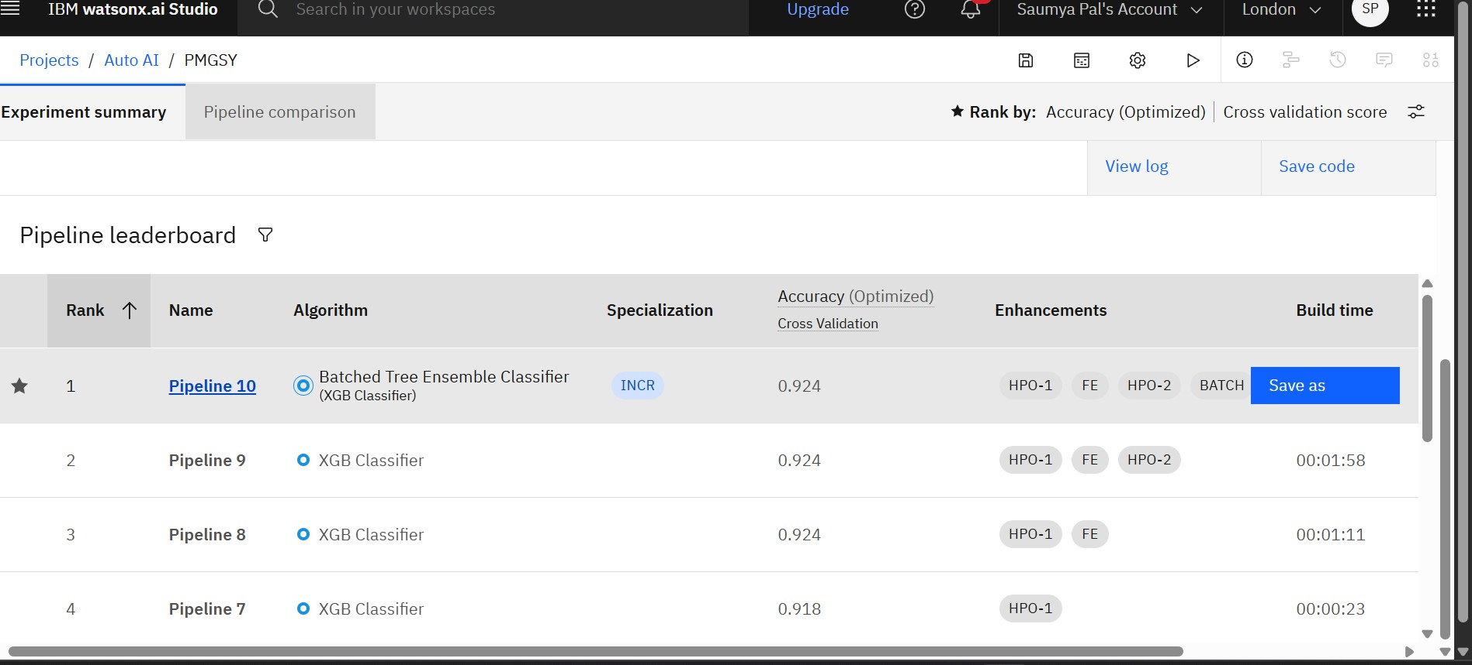
RESULT
Best Model:
Batched Tree Ensemble Classifier (XGB Classifier)
Cross-Validation Accuracy: 92.4%

Slide 10
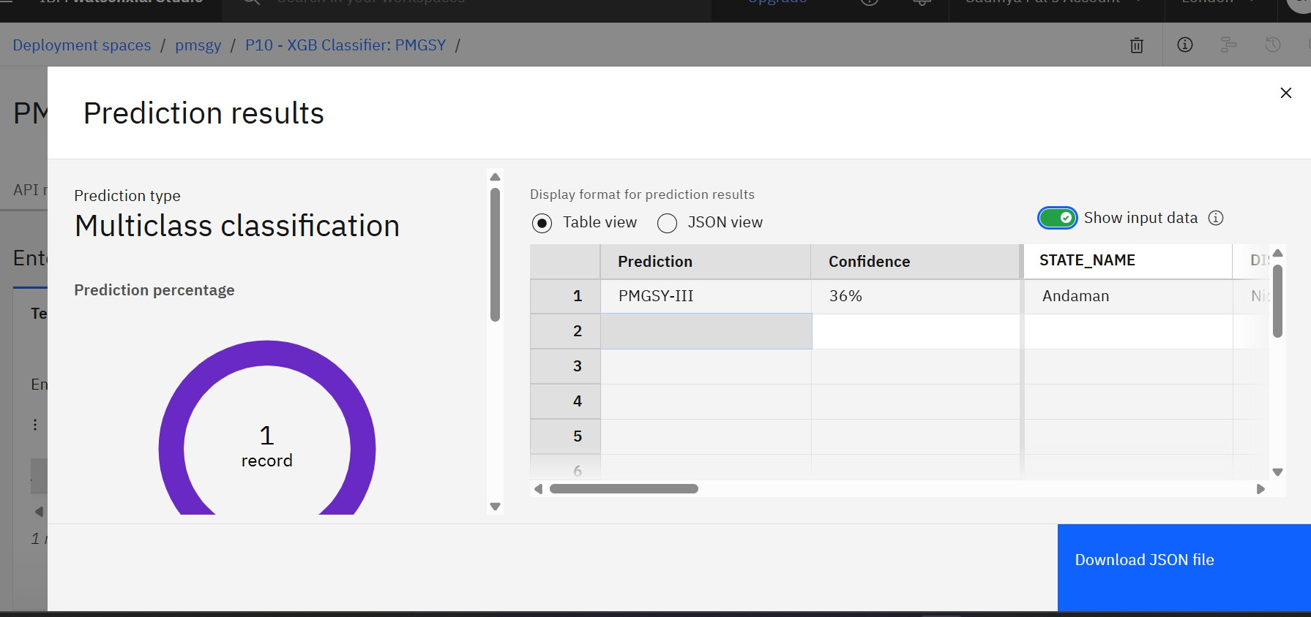

Slide 11
CONCLUSION
An effective classification model was built for PMGSY scheme categorization.
Used IBM Cloud AutoAI for rapid model generation and evaluation.
Achieved high accuracy of 92.4% with real project-level features.
Significantly improves speed and reliability of rural project monitoring.

Slide 12
FUTURE SCOPE
Integrate map-based data or terrain classification.
Incorporate time-series progress tracking using expenditure data.
Enable real-time classification via mobile app or web dashboard.
Analyze for fairness and regional bias.

Slide 13
REFERENCES
PMGSY Official Portal – https://pmgsy.nic.in
AI Kosh Dataset – https://aikosh.indiaai.gov.in
IBM Watson Studio & AutoAI Documentation
scikit-learn API Reference
Hands-On Machine Learning
Github link: https://github.com/saumyapal614/AICTE_IBM_edunet_ML
Dataset link: https://aikosh.indiaai.gov.in/web/datasets/details/pradhan_mantri_gram_sadak_yojna_ pmgsy.html

Slide 14
Github link: https://github.com/saumyapal614/AICTE_IBM_edunet_ML
Dataset link:
https://aikosh.indiaai.gov.in/web/datasets/details/pradhan_mantri_gram_s adak_yojna_pmgsy.html

Slide 15
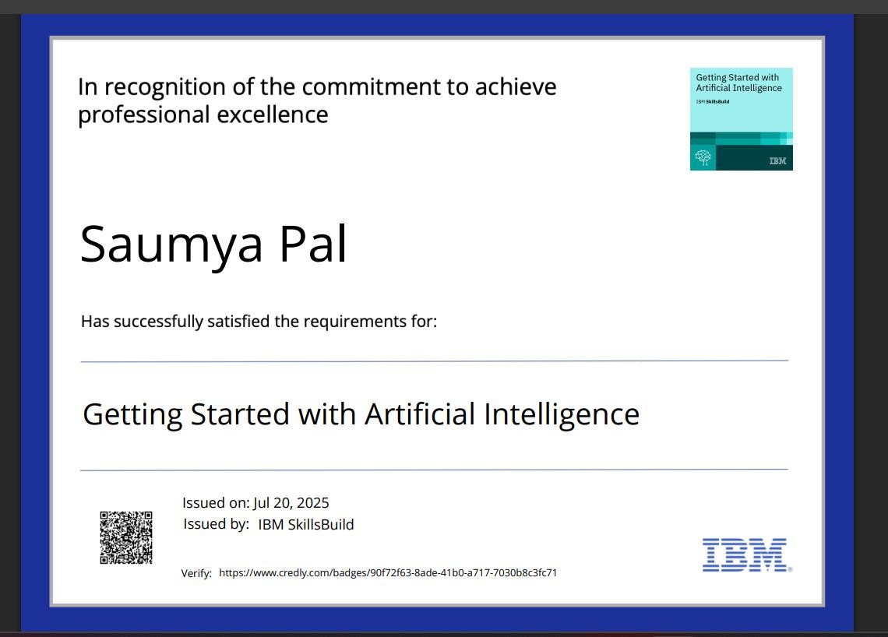
IBM CERTIFICATIONS

Slide 16
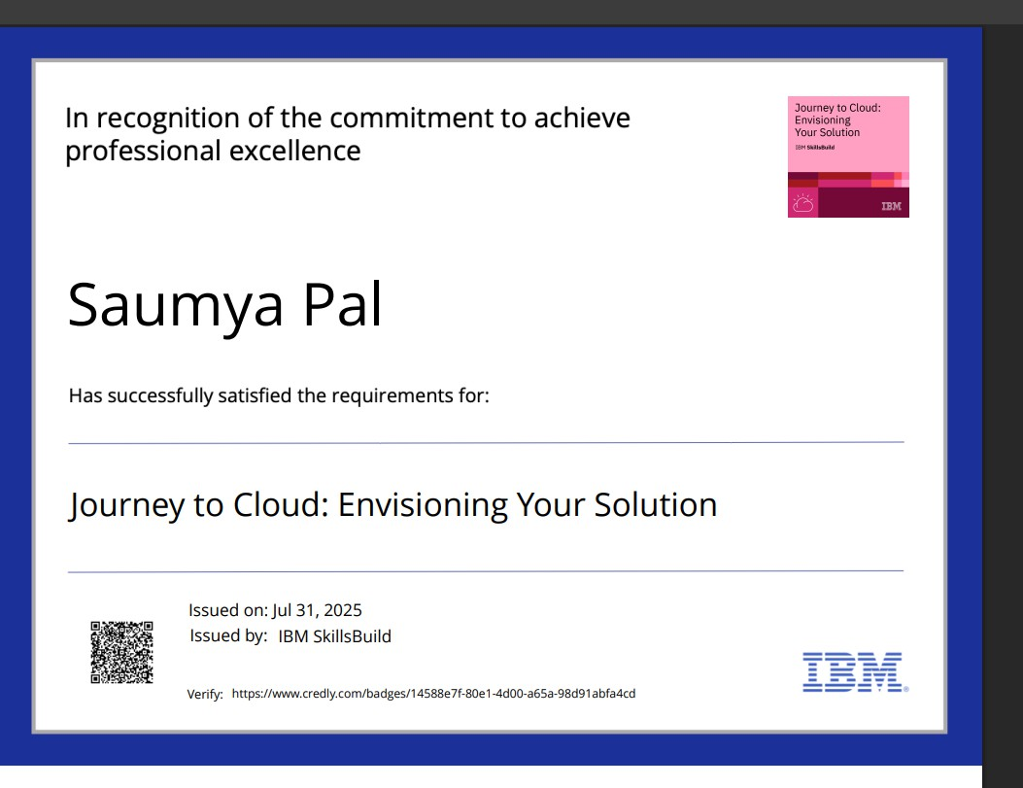
IBM CERTIFICATIONS

Slide 17
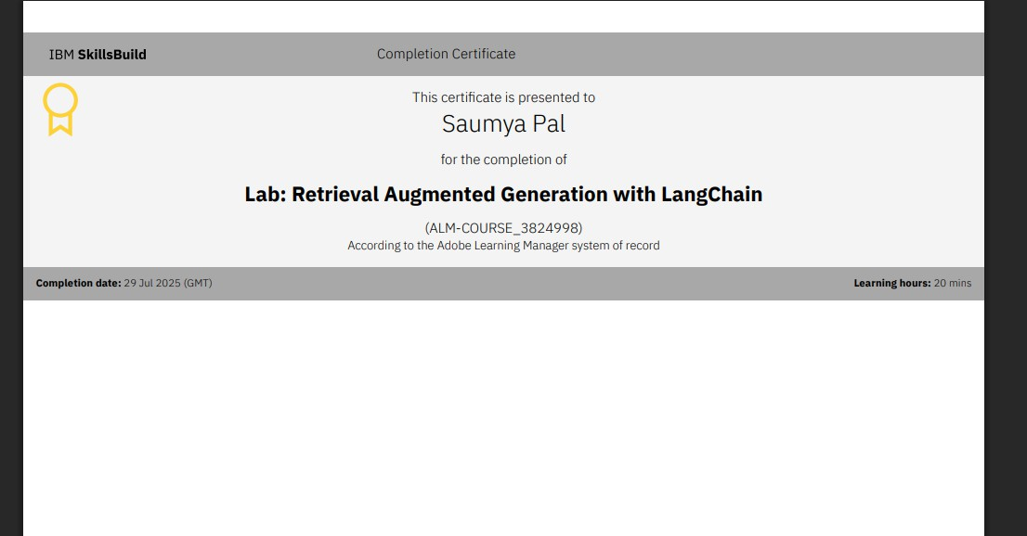
IBM CERTIFICATIONS

Slide 18
THANK YOU

